Slide 1

How to SOLVE
Fitch’s Paradox of Knowability
Lorenz Hehrofer
Mean Business - WE DO!

Slide 2
History of Paradox of Knowability
The paradox of knowability is well-known to all philosophers streams world globally defining the scope of knowledge accessible to mankind. There are four scopes of knowability:
Known
Knowable
Unknown
Unknowable

Slide 3

1. How To Solve Fitch’s Paradox
By default unknowable is inaccessible to mankind, solving Fitch’s Paradox we make accessible total of universe
DSI
What is DSI and how it works
Maths
How to find unknowable scope
Solved Paradoxes
Fitch’s Paradox Solution is mandatory have Applied Science invention

Slide 4
DSI, how to solve infinite data arrays O(1) complexity
We use fractal mathematics to solve unknowable and paradox solutions at a global knowledge range
Matrix n defining parameters of DSI(n) if defining solution of Deterministic Search Of Uncountable Unordered Infinite Data Arrays of O(1) complexity using Fractal Mathematics define only one solution and only one value of result.

Slide 5
Fitch’s Paradox Mathematics
We define f(x) = DSI(n)
f - function performing search
DSI - Deterministic Search Of Infinity algorithm
n - Search algorithm parameters
x - searched parameters $$
Searching for a KNOWLEDGE at specific range parameters we receive
K N O W L E D G E E X I S TS
The finding of all required solution is a prank, process is slow by nature and
WE DO first shot

Slide 6

Finding all universe knowledge is POSSIBLE

Slide 7

2. Examples
By the end of this section, your audience should be able to visualize:
Interstellar Data Compression 8,000,000,000 TB of data compressed to 96 bytes using Fractal Maths and O(1) speed
What is the pain you cure with your solution?
Cashout Corporate Patent
Show them a specific person who would benefit from your solution.

Slide 8
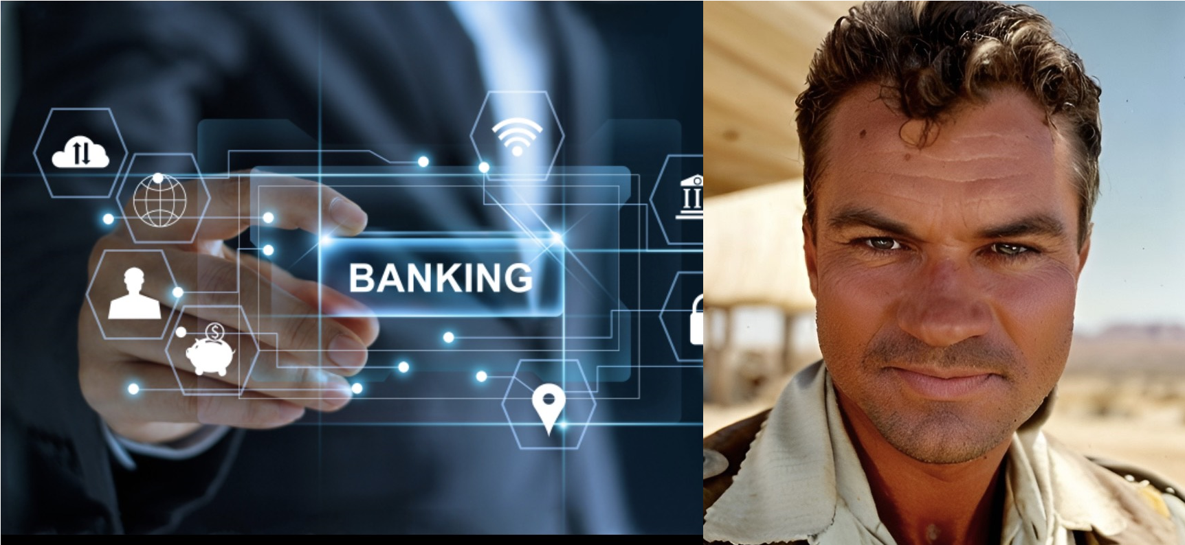
Lorenz Herhofer, CEO, PhD
Herhofer Space Group
Herhofer Space University
We broke four realms of infinity:
Infinity
Matter
Perception
Knowability

Slide 9
Good luck!
We hope you’ll use these tips to go out and deliver a memorable pitch for your product
or service!her
For more (free) presentation tips relevant to other types of messages, go to
herhoferspacegroup.uk
Mean Business - WE DO!

